Slide 1
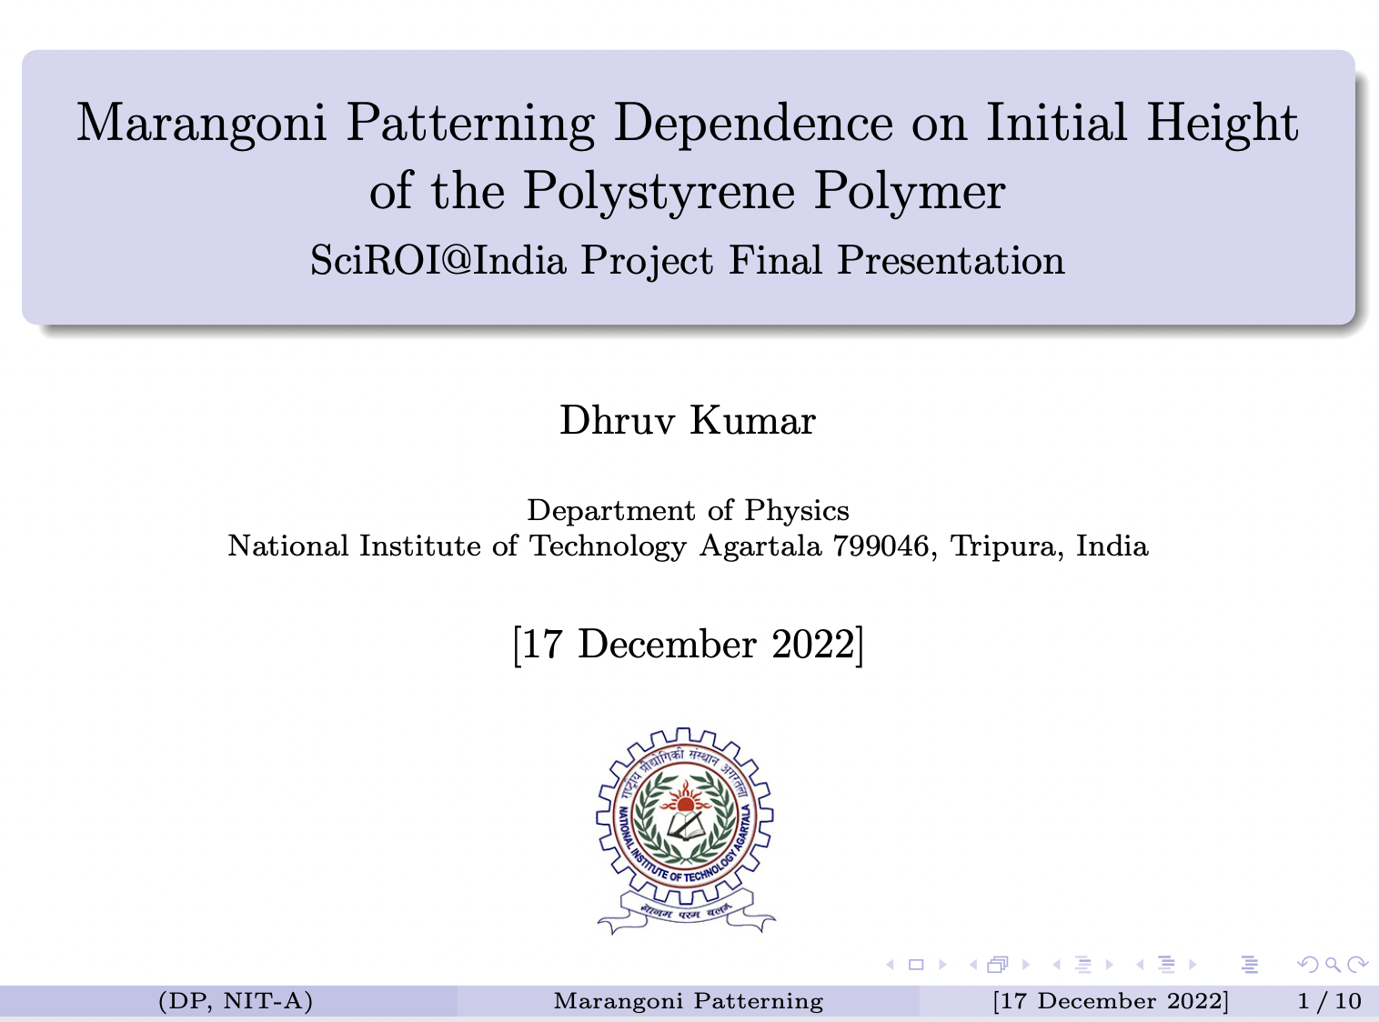

1

Slide 2
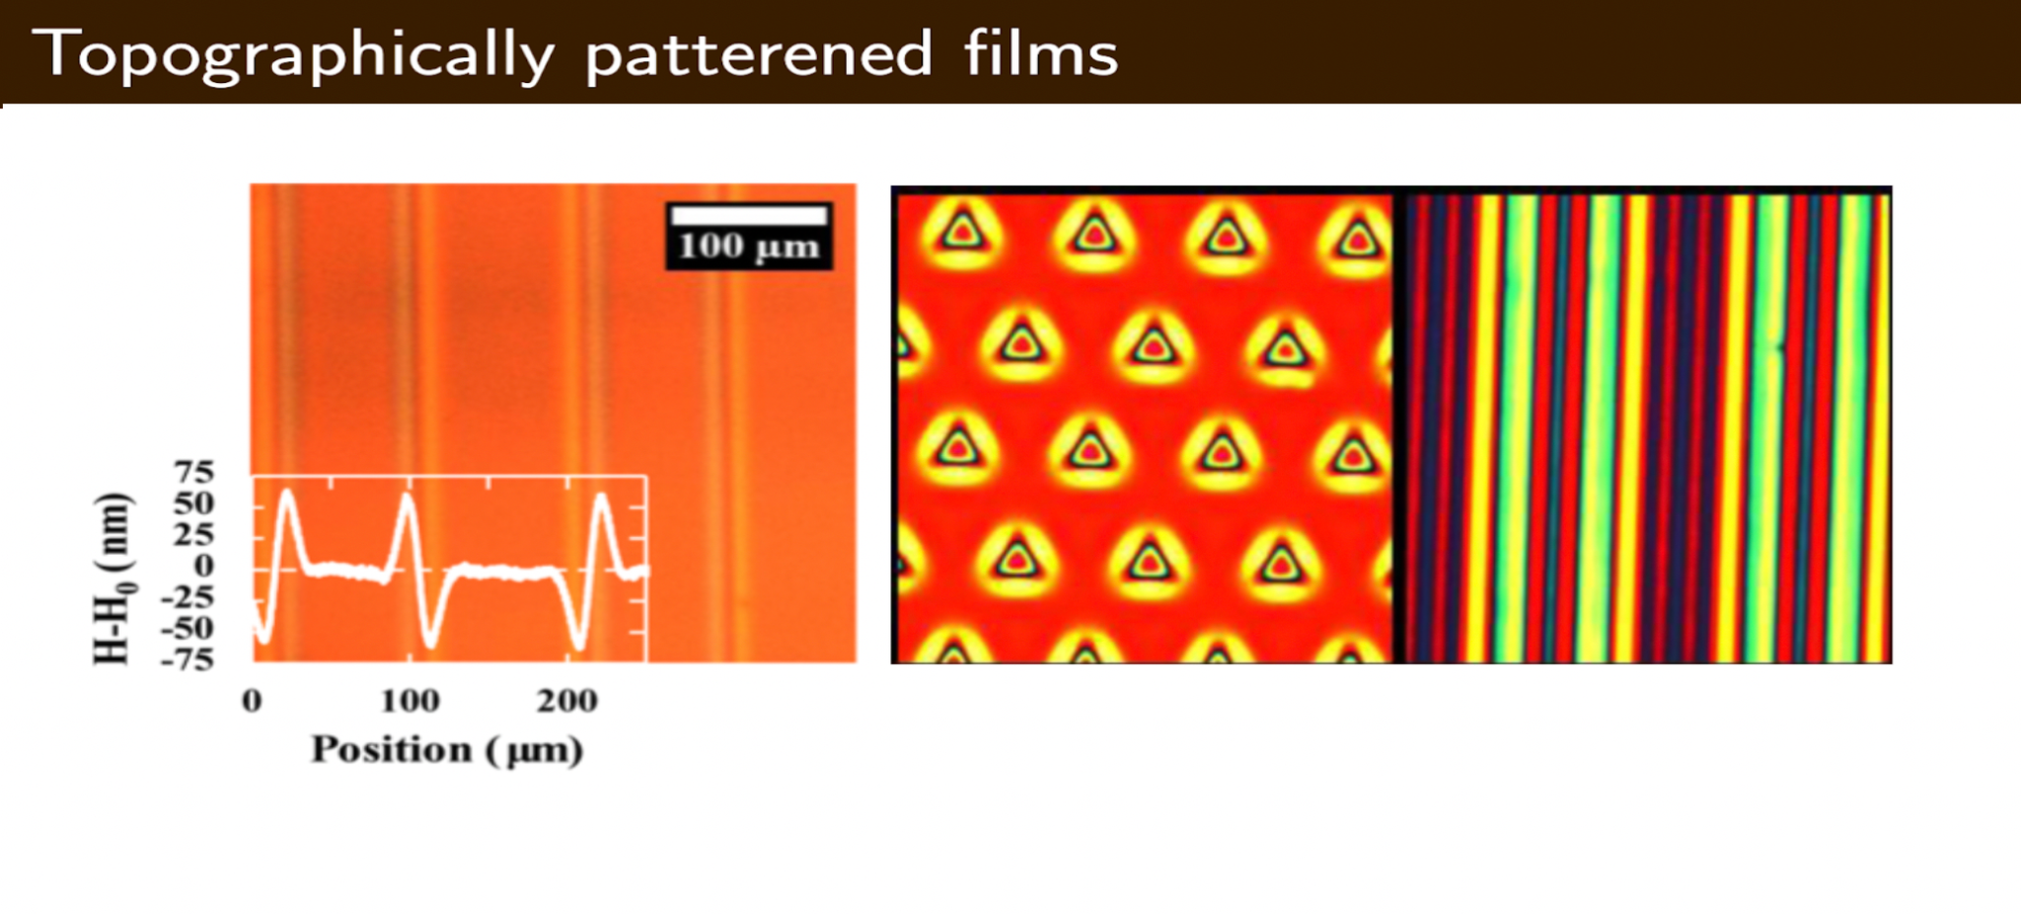


Fig1: Various line pattern periods created in thick Polystyrene(PS) with overlaid profilometry traces showing topography formed by using photomasks with different line spacing. [Joshua M.,Katzenstein: Patterning by Photochemically Directing the Marangoni Effect 2012]
2

Slide 3
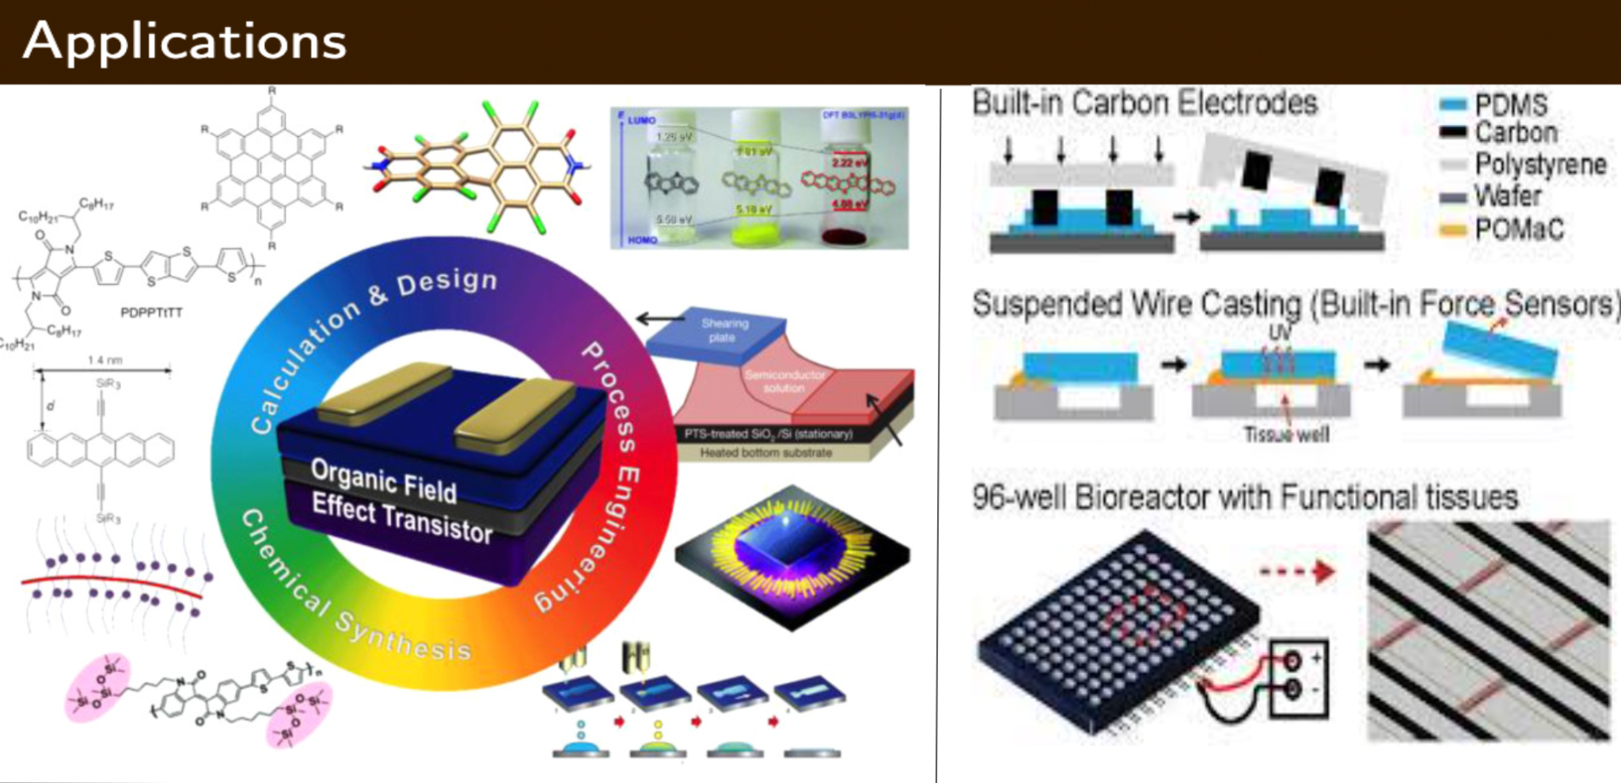
Manufacturing of Semiconductors
Lei Fang: Integrated Materials Design of Organic Semiconductors for Field-Effect Transistors

Slide 4
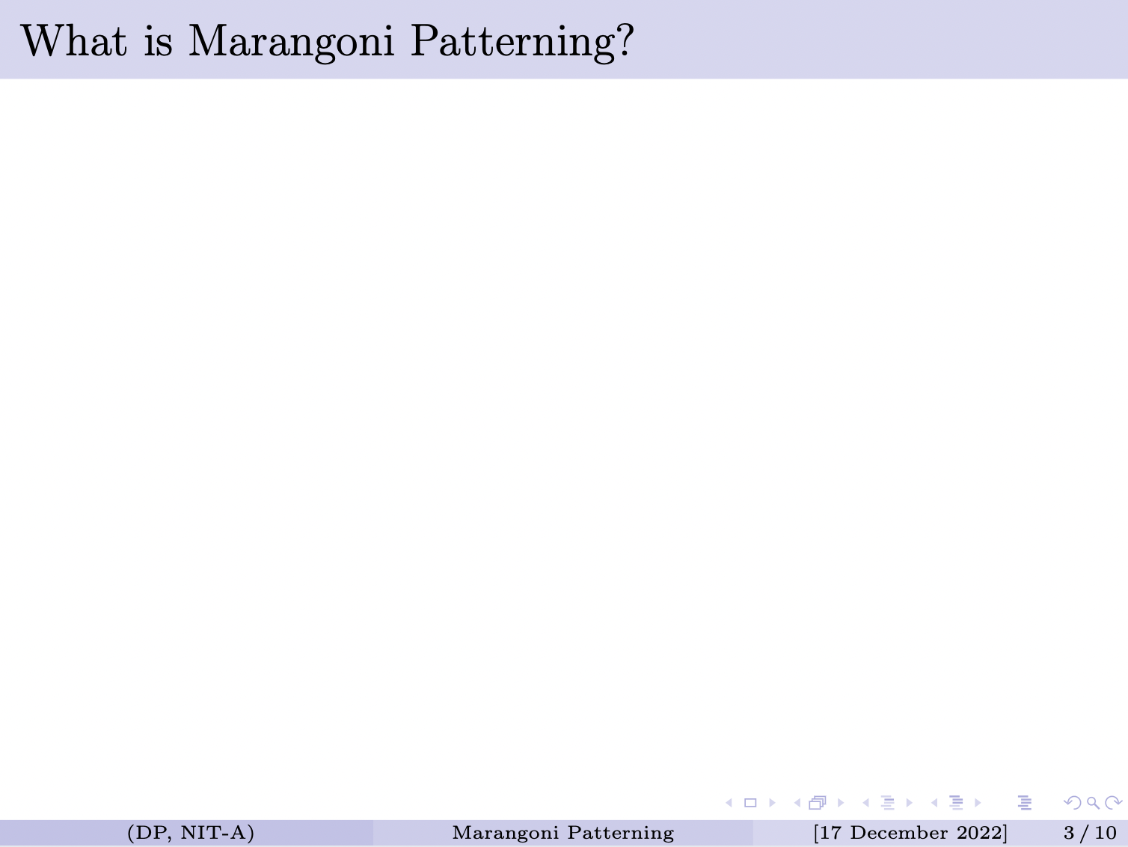
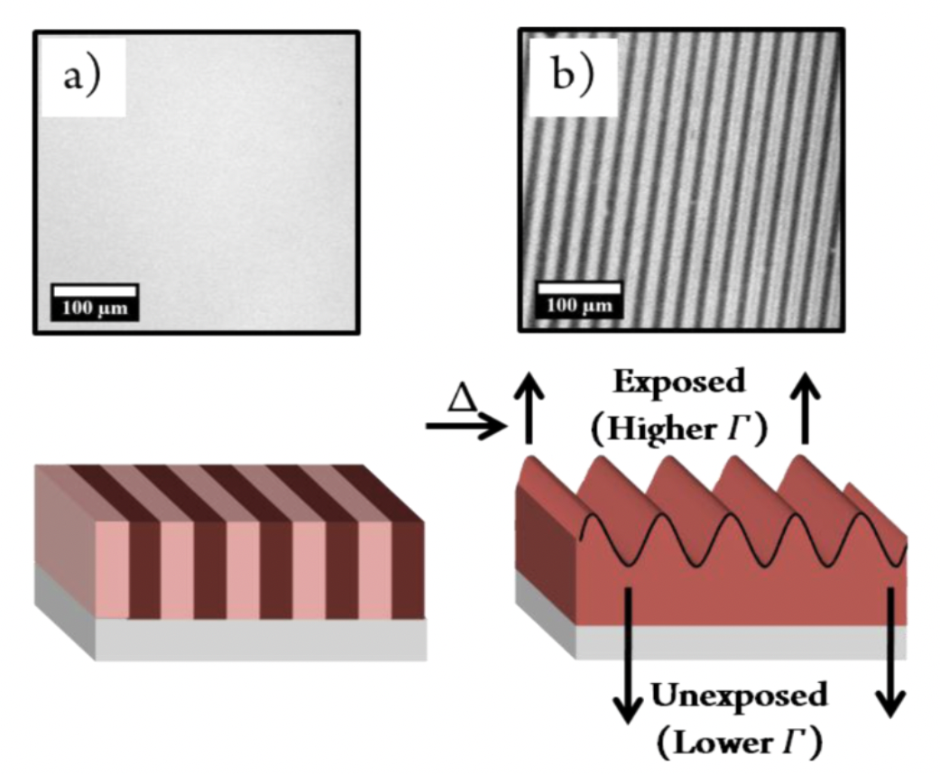
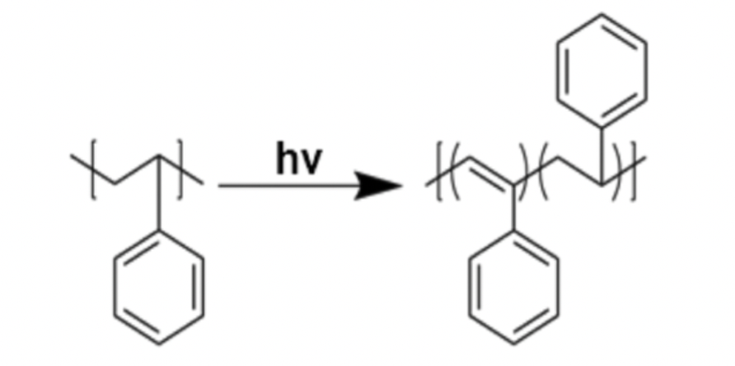

Exposure of Polystyrene polymer to UV rays through photomask which induces a photochemical reaction in exposed regions.
This is responsible for the surface pattern that leads to Marangoni flow and topographical pattern formation.
[Joshua M.,Katzenstein: Patterning by Photochemically Directing the Marangoni Effect 2012]
3

Slide 5

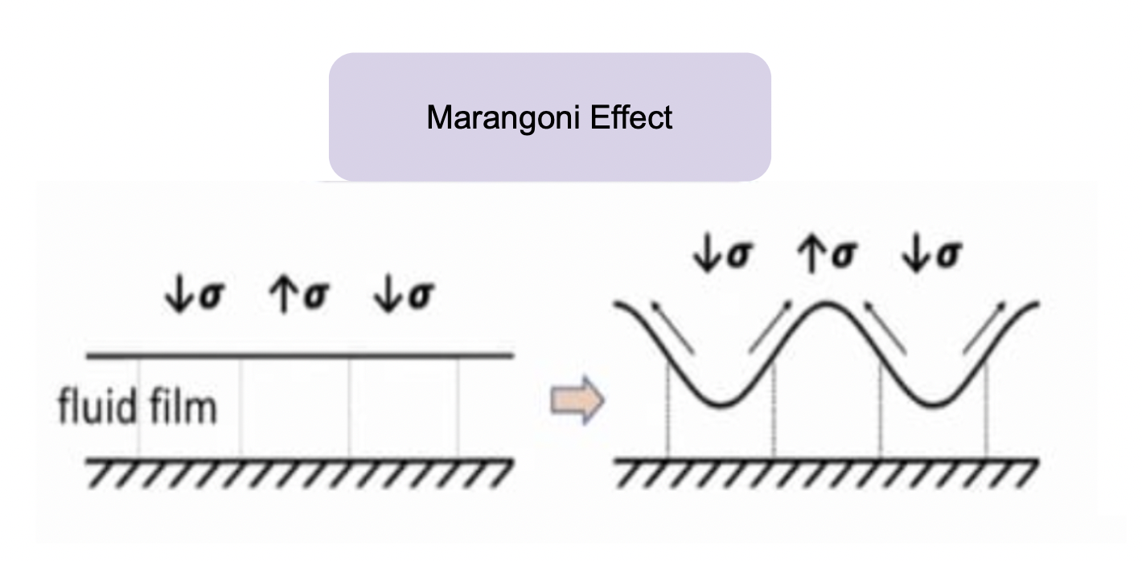
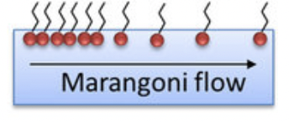

1.
Low 𝝈
High 𝝈
(𝛔) - Surface Tension Gradient
4

Slide 6

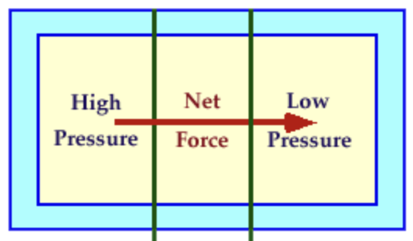
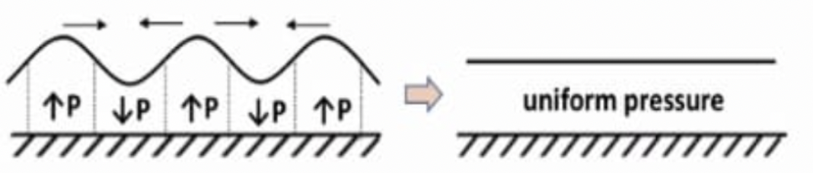

2.
Capillary leveling
(P) - Pressure Gradient
5

Slide 7

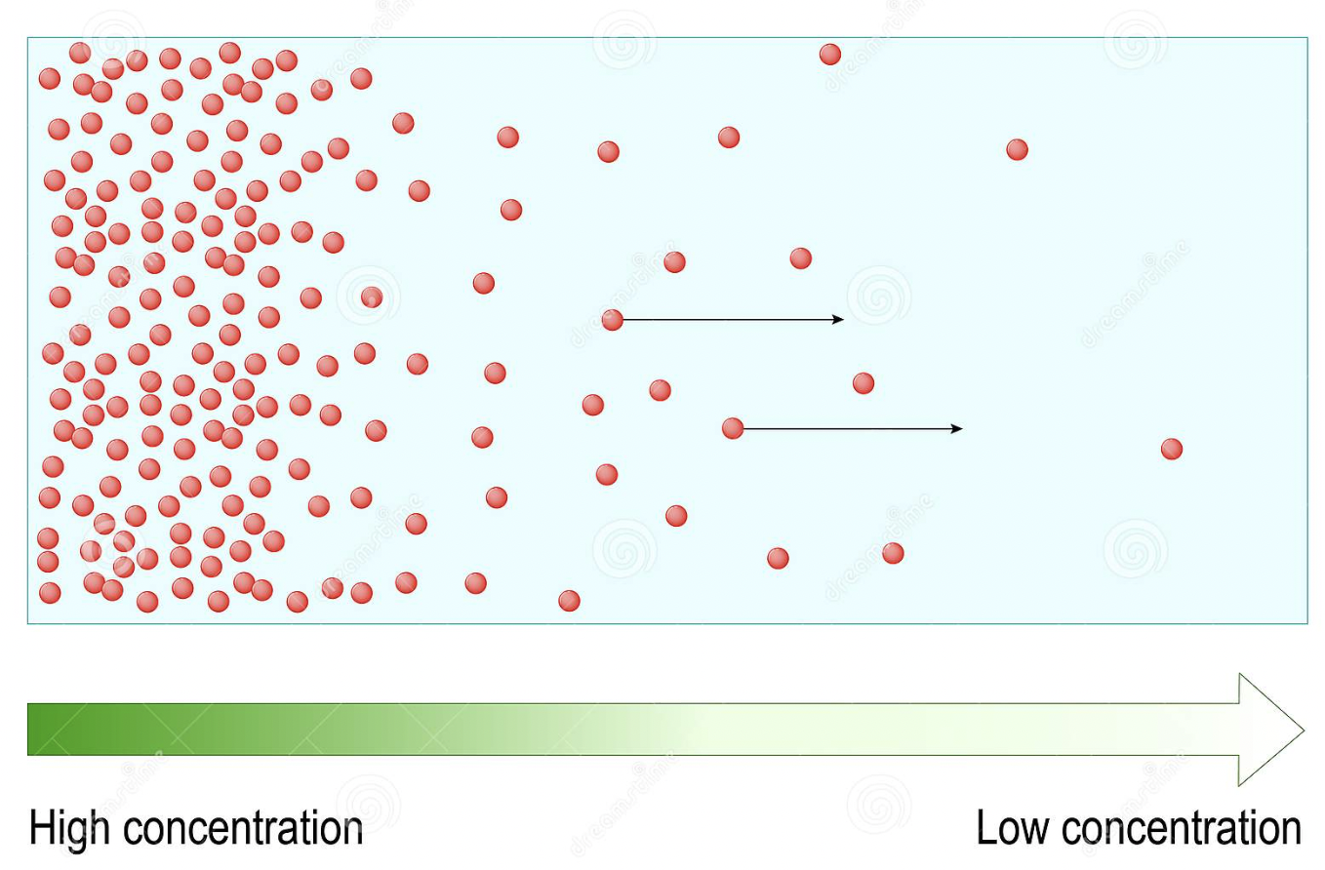
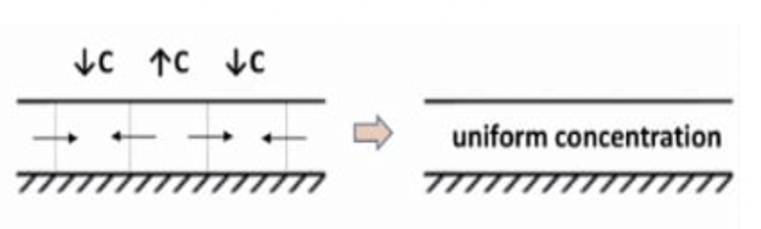

3.
Diffusion Effect
(C) - Concentration Gradient
6

Slide 8

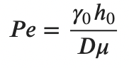
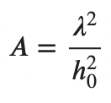
Peclet number (Pe) is the ratio advection rate of a flow to its diffusion rate.
The capillary number (A) is defined as the ratio of viscous to interfacial forces.

Slide 9
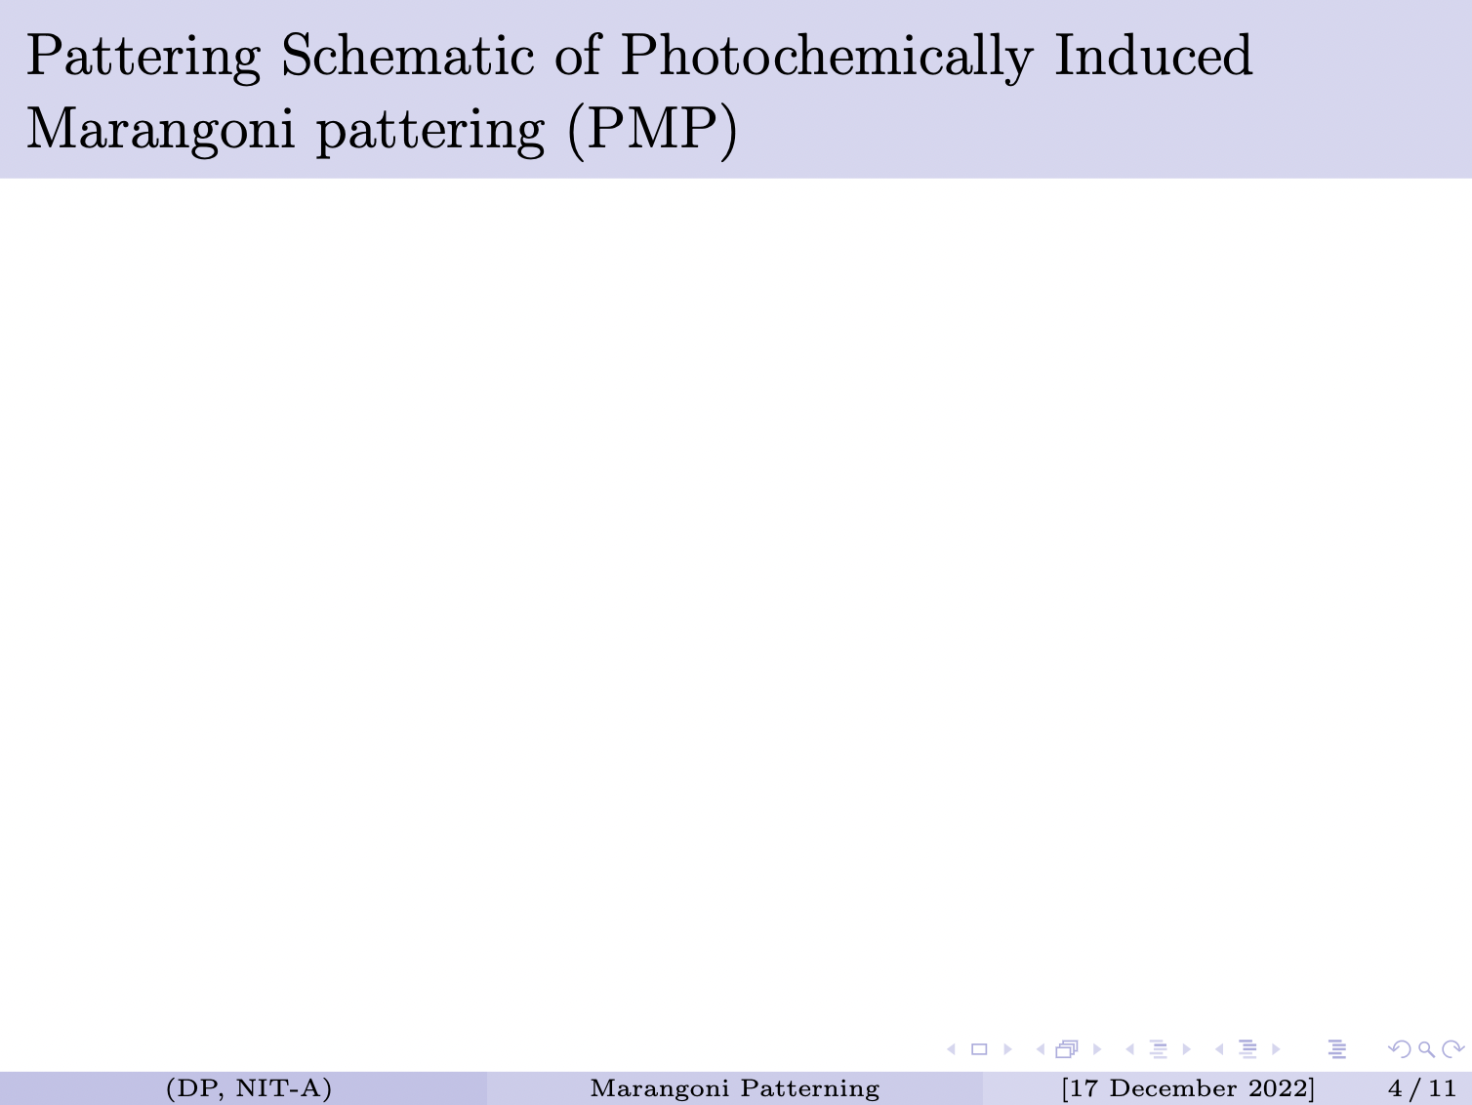
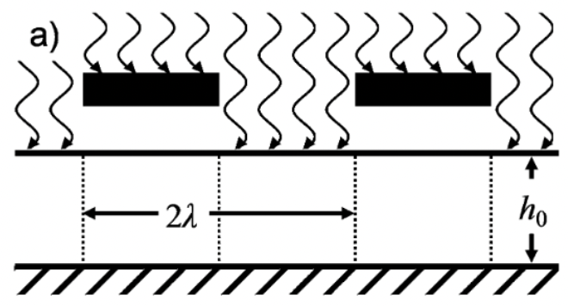
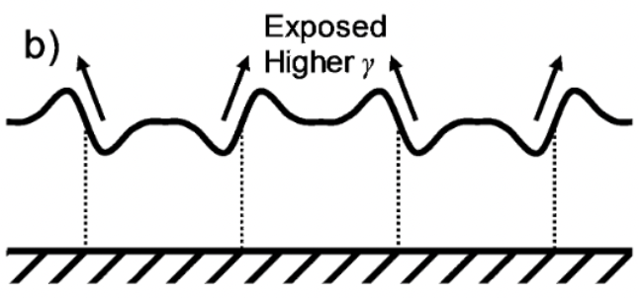
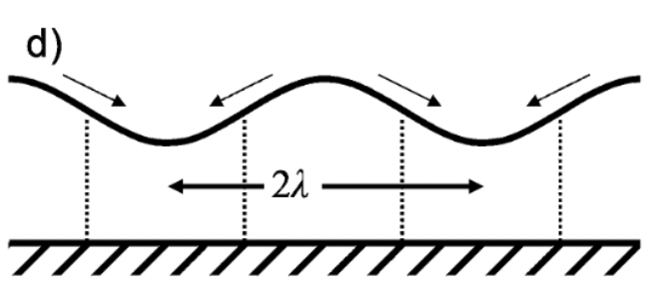
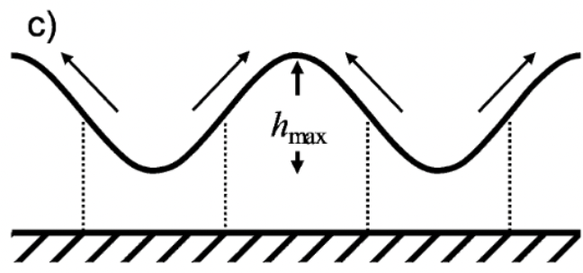

Thermal Annealing after some time
Further Thermal Annealing after some time
Further Thermal Annealing after some time
(λ) - Wavelength ; (h_{max}) = maximum distance of peak and valley from the (h_{o}) mark ; (𝛄) - surface tension.
[Precision Marangoni-driven patterning : Talha A. Arshad]
7

Slide 10

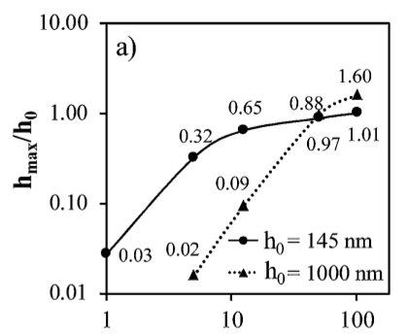
To determine the behavior of n_{max} with (normalized peak-to-valley height) with respect to increasing h_{o} (the initial height of the polymer), two limiting cases were constructed.
[Joshua M.,Katzenstein: Patterning by Photochemically Directing the Marangoni Effect 2012]

Slide 11

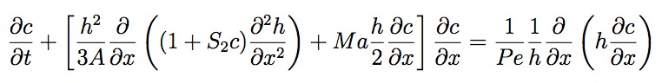
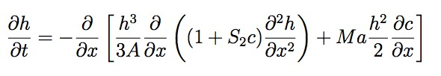
– (1)
– (2)
(P_{e}) - Peclet number, (A) - Capillary number, (M_{a}) - Marangoni number, (h) - Thickness of the film, (𝝺) - Photomask half periodicity, (c)- Mole fraction of the photochemical product.

Slide 12

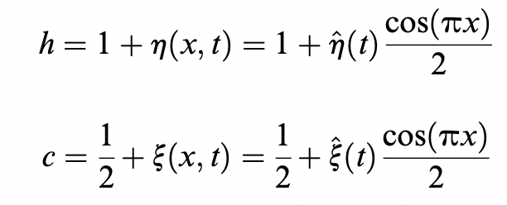
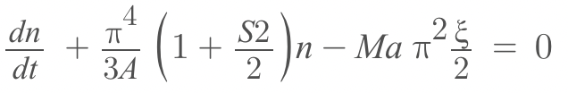
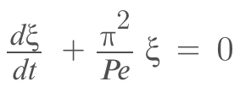
Linearised Equations -
By using Perturbation method, we get these simplified equations -
-(3)
-(4)

Slide 13

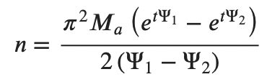
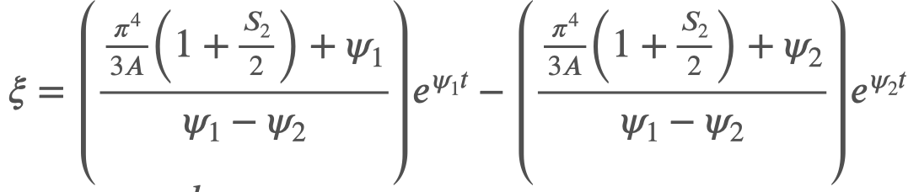
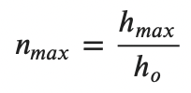
On solving (3) and (4) we get,
Also we know that -

Slide 14
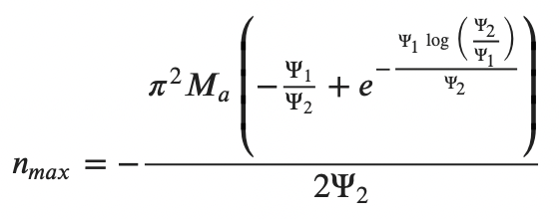

Slide 15

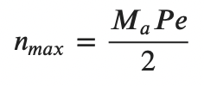
Case 1: h₀
0
(A>>P_{e})
n_{max} 𝞪 P_{e} 𝞪 h₀
For small values of h_{o} , the n_{max} shows a linear dependence on h₀

Slide 16

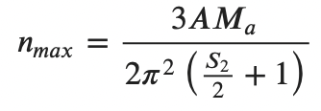
Case 2: h₀
∞
(P_{e}>> A)
n_{max} 𝞪 A 𝞪 1/h²₀
For larger values of h_{o} , the n_{max} shows a inverse square dependence on h₀

Slide 17

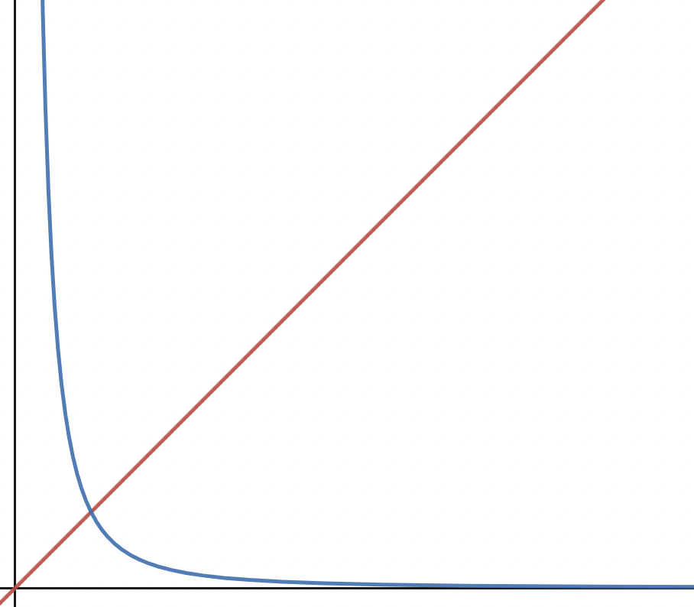
(P_{e}, A)
n_{max} = 1
A>>P_{e}
P_{e}>>A
(h_{o})

Slide 18

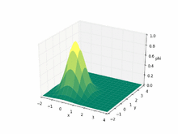
For Pe >> A :
The advection rate is High.
Hence, the transport of a substance or quantity by bulk motion of a fluid will be more.
[https://en.wikipedia.org/wiki/Advection]
For A >> Pe :
The viscous force is High.
Hence, the resistance force that is given by the fluid will be high.

Slide 19

In this presentation, the behavior nmax is explained for very low as well as very high value of h_{o}. The results can be significantly helpful for selecting the correct height polymer film to get desired values of n_{max}.

Slide 20

[1] Precision Marangoni-driven patterning Talha A. Arshad, Chae Bin Kim, Nathan A.
[2] Long-scale evolution of thin liquid films Alexander Oron*,Stephen H. Davis,S. George Bankoff.
[3] Patterning by Photochemically Directing the Marangoni Effect Joshua M. Katzenstein, Dustin W.
[4] Transport Phenomena (2nd Edition) Bird, Steward and Lightfoot.
[5] Intermolecular and Surface Forces J. Israelachvili
[6] Machine Learning for Fluid Mechanics Steven L. Brunton,Bernd R. Noack.

